Slide 1

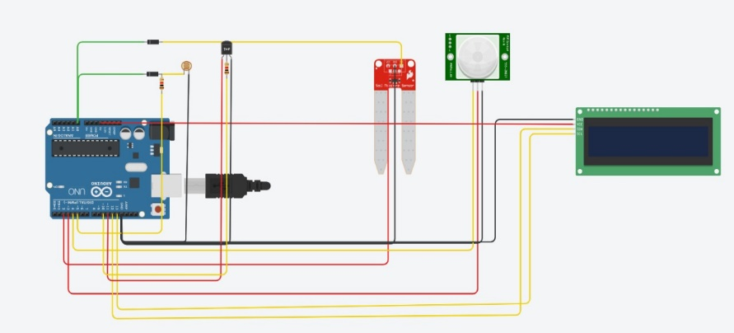
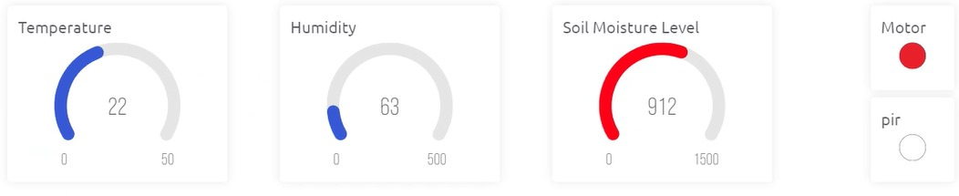
ECEN305
IoT based control and automation of smart irrigation system
Course Name: Introduction to computer systems
Prof. Name: Dr. Mohamed Saeed Darwesh TA: Eng. Kareem Mohamed Moussa
Abstract
This poster showcases a state-of-the-art smart farming system that uses a smart integration of temperature, light-dependent resistor (LDR), ultrasonic, and passive infrared (PIR) sensors to transform conventional farming methods. Enhancing farm safety, maximizing crop growth, and advancing sustainable farming methods are the system's main goals.
Introduction
In today's dynamic agricultural environment, combining state-of-the-art technologies is essential for effective and sustainable farming methods. This poster presents a smart farming system that has been engineered to incorporate cutting-edge sensor technologies, such as temperature, light-dependent resistor (LDR), ultrasonic sensor, soil moisture sensor and passive infrared (PIR) sensors. This introduction sheds light on the integration between these sensor technologies and explains how they work together to improve crop management, farm safety, and resource-efficient cultivation techniques.
Result
Presently, an intelligently configurable smart irrigation system has been implemented, tailored to individual preferences, and is accessible through a variety of smart devices, enhancing the convenience and flexibility of irrigation management.
The system precisely evaluates temperature's impact on crop growth, providing users valuable insights into the correlation between temperature fluctuations and moisture levels, enhancing understanding of crop development dynamics.
Methodology
In our project we use ESP8266 as a microcontroller and as it is low-cost Wi-Fi microchip. We use variant analog and digital sensors.
1- soil moisture sensors plays a pivotal role in optimizing water usage and monitoring its moisture content and take specific actions.
2- PIR sensor is used to detect motions in the farm effectively, resulting in timely alerts and deterrents to protect crops from thieves.
3- Temperature sensor (DHT11) plays a vital role in monitoring the climate change to crop the plants in appropriate time
4- LDR sensor is also used for nighttime watering, which guarantees effective hydration during ideal conditions.
5- Internet of Things (IoT), cloud-based data storage, and an easy-to-use user interface are all part of the system's architecture, which allows for remote monitoring and control (Blynk).
Team members:
Mohamed Tamer Shebita
Ahmed Salah Kamal Jaser Osama Kassim Zeiad Ehab Alfahham Osama Tharwat Ali

